Slide 1

Tips for Writing a Research Abstract and Creating a Research Poster Kim Siegmund
Adapted slides from
Cecilia M. Patino-Sutton MD PhD MeD
https://profiles.sc-ctsi.org/cecilia.patinosutton
Notes:
CTSI -
Clinical Translational Science Institute

Slide 2
Goals for today
Introduce SC CTSI and why I am interested in you!
Introduce you to some useful resources
Writing a scientific abstract
Developing a scientific poster
Go over practical recommendations
Discuss roadblocks to creating research abstracts and posters

Slide 3


Slide 4
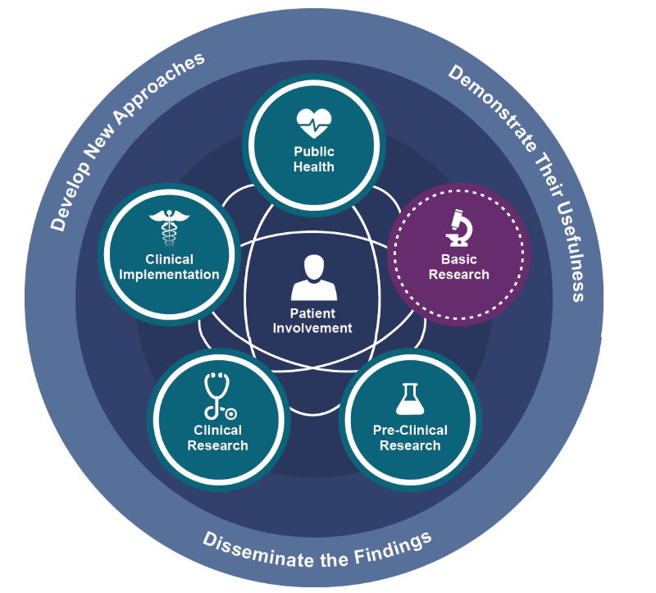
Clinical and Translational Research Paradigm
https://ncats.nih.gov/translation/spectrum
Impacto
▾Severidad
▾Internaciones
▾Costo
▾Mortalidad
▵Calidad de vida
Notes:
Funding: NIH National Center for Advancing Translational Sciences
Explain the translational paradigm and our obligation to propagate translation.
Translational Science Spectrum
The spectrum represents the stages of research involved in bringing more treatments to all people more quickly

Slide 5
Why I am Interested in You.....
I am interested in improving the health of humans by training researchers to conduct high quality, rigorous and reproducible research studies
High quality research has a better chance of improving the health of individuals
High quality reporting of research has a better chance of getting buy-in from the health community and thus getting translated to health care decision making.

Slide 6
Why I am Interested in You.....
As a researcher you will need to write research abstracts and present posters:
As part of a research training program
When presenting your research at a conference
When Applying for a grant
When Publishing
Thus, high quality reporting of research within the context of a research abstract and a poster are of key importance
The abstract and poster may be the only product that is read by the research community!

Slide 7
Research Abstract: Definition
It is an abbreviated and structured description of a research study
Short summary of the completed research

Slide 8
Have you ever written a Research Abstract?
What strategy did you use?

Slide 9
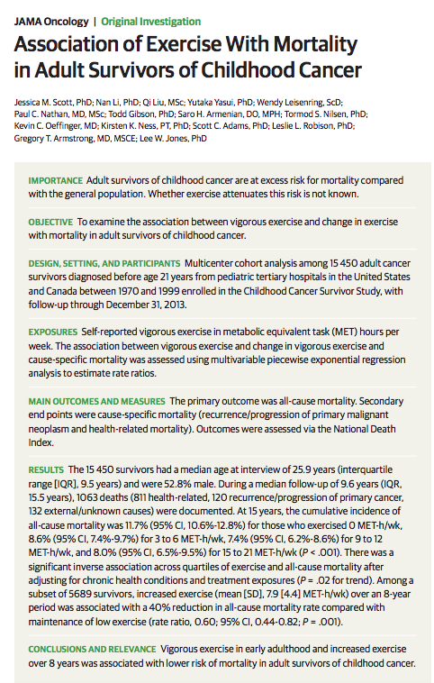
This is a study about association between and exposure and an outcome.
What other types of studies are there?
The sections of the abstract can vary based on the type of study it is.

Slide 10
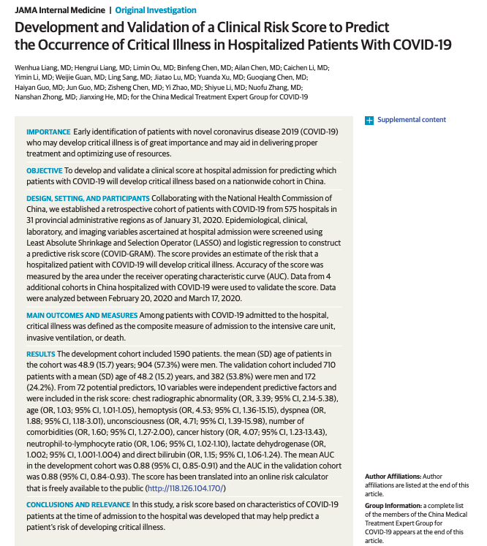

Slide 11
What other types of study designs are there?
Prediction Models
Association Models
The structure and information of an abstract will depend on the study design of the research.

Slide 12

A tool to help you write a rigorous abstract for your study.
https://www.equator-network.org/reporting-guidelines/

Slide 13

https://www.equator-network.org/reporting-guidelines/

Slide 14
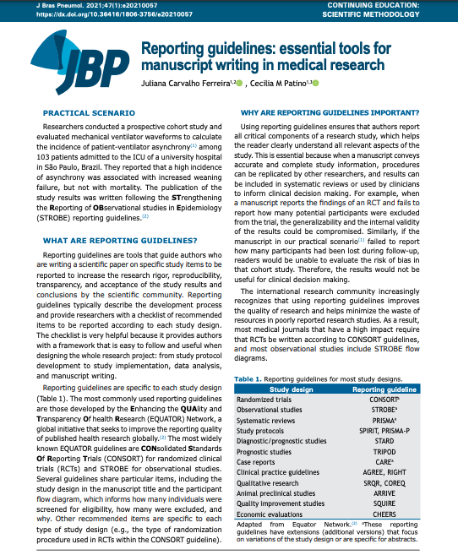
What is a reporting guideline?
It is a tool that guides researcher, when writing scientific papers, on the items that should be included in each sections of the paper, including the ABSTRACT!!!
The items of a reporting guideline will depend on the study design of the study.

Slide 15
https://www.equator-network.org/reporting-guidelines/

Slide 16
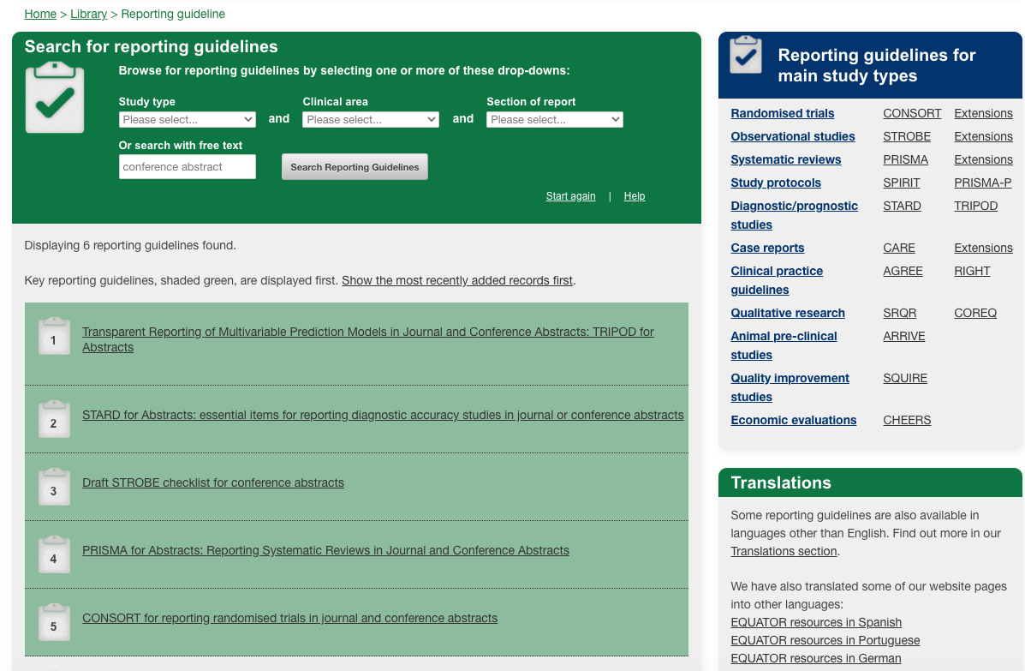

Slide 17

Association of Exercise With Mortality in Adult Survivors of Childhood Cancer

Slide 18
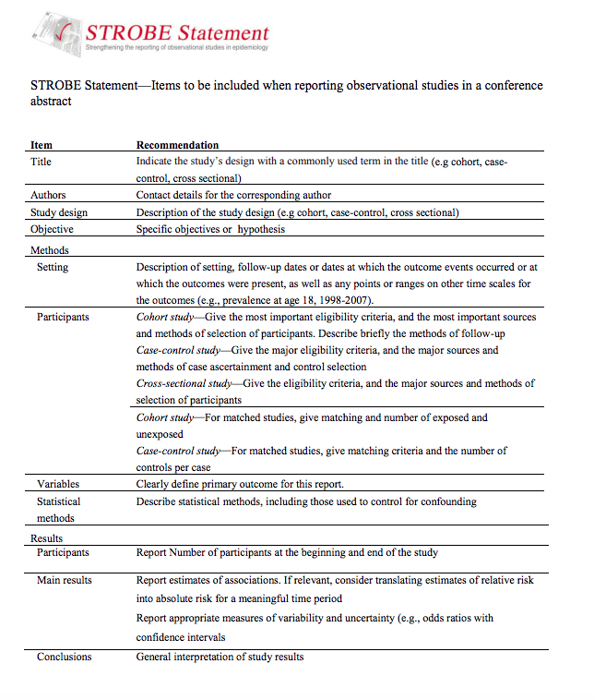
Link to reporting guideline

Slide 19
Abstract: Summary and Lessons Learned
Specific section that you need to write, and format according to the study design
There are very useful online resources that can guide you (EQUATOR network)
Title should ALWAYS! include the study design
Abstracts should catch your audience’s attention!
Using reporting guidelines makes the process of writing more efficient

Slide 20
Have you ever created and presented a Research Poster?
What strategy did you use?

Slide 21
Poster Presentation
Goals
Develop skills
Data management and exploration
Develop and implement a data analysis plan
Summarize the research results
Interpret the research results
Teamwork
Poster development and presentation
Summarize the setup of the study from which the dataset came from
Describe the methods used in analyzing the data
Describe the main findings from the analysis
Describe the conclusions drawn from the main findings

Slide 22
Research Presentation
Prepare a poster summarizing your goals, methods, and main findings
Prepare a 4-minute group presentation summarizing your poster
Record the group presentation on Monday of the final week of the program
Present at a poster presentation on the last day of the summer program

Slide 23
LA BeST Poster Presentation Guidelines
Each group will produce one poster (multiple copies), on which all group members are expected to contribute. Your poster should include:
A descriptive title and a listing of all members of each group along with affiliations – each author should be listed 1st on one copy of the poster
A summary of the overall setup, methods, data description, main findings, and conclusions from each group project
Acknowledgements of funding sources, and individuals/groups that have helped with the conduct of the project and/or preparation of the poster
Poster dimensions: Poster boards are landscape format (short and wide)
Poster dimensions are (24 inches height x 36 inches width)

Slide 24


General Poster Rules
3 min summary of your work
Visual appealing and clear
Repeat main points at least twice
QR code to your lab or personal website
May be viewed when you aren’t present
https://www.qrcode-monkey.com/
https://www.qr-code-generator.com

Slide 25
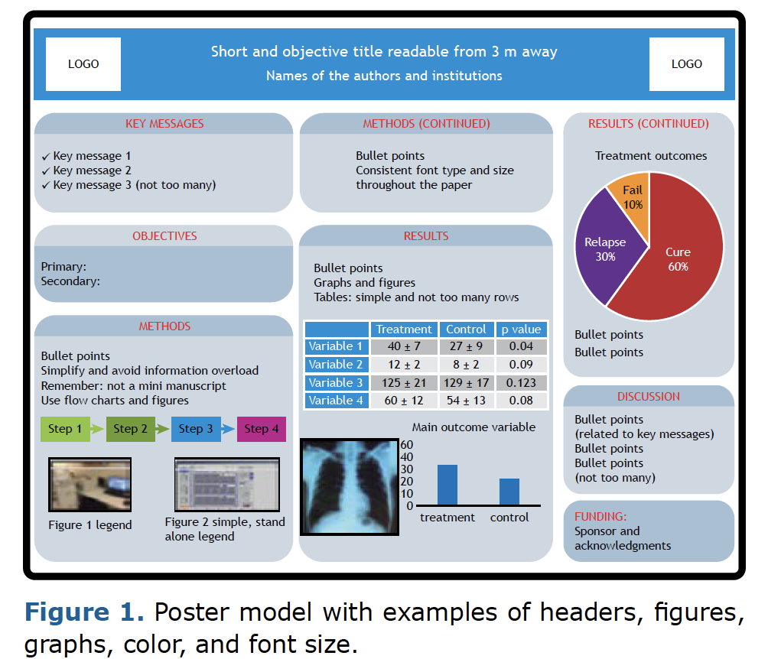

Poster Layout

Slide 26
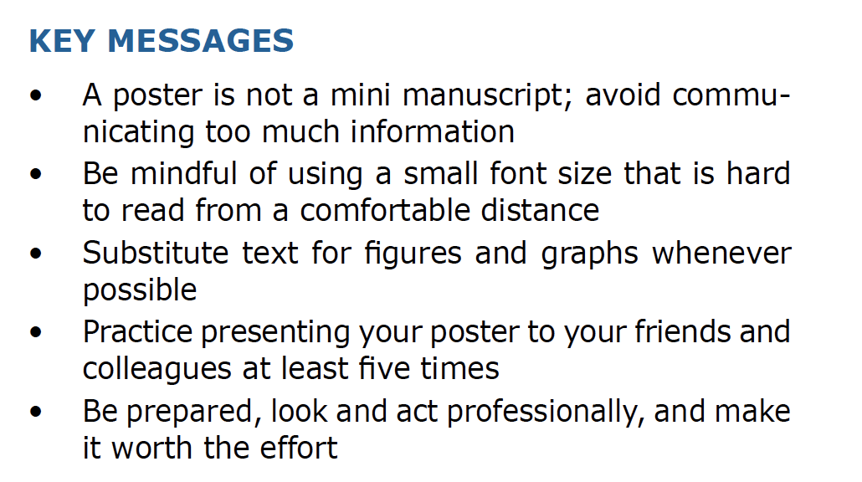

Slide 27
LAsBeST@USC Instructions
Prepare poster summarizing
Goals
Methods
Main findings
Things to include:
Describe the data
summary statistics
visualization techniques
Fit models
Summarize finding using tabular and/or graphical displays
Provide interpretation of main findings and final models

Slide 28
Each Project has a QR code
Group 1: EV Project
Group 2: HELIX Project
Group 3: All of Us GWAS
Group 4: Heart Transplant
Group 5: Single cell RNAseq

Slide 29
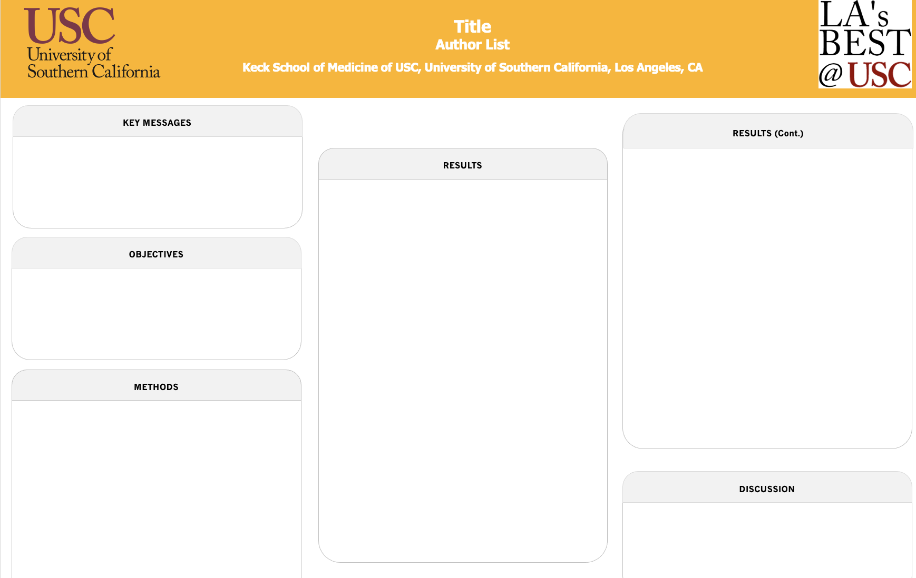
You have access to a template

Slide 30
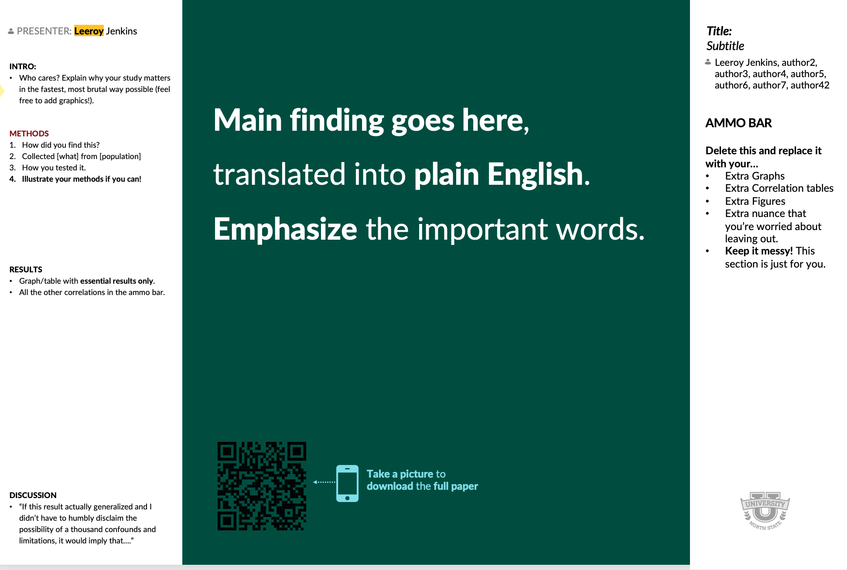
You are invited to get creative
But keep the
logos and
acknowledgements

Slide 31
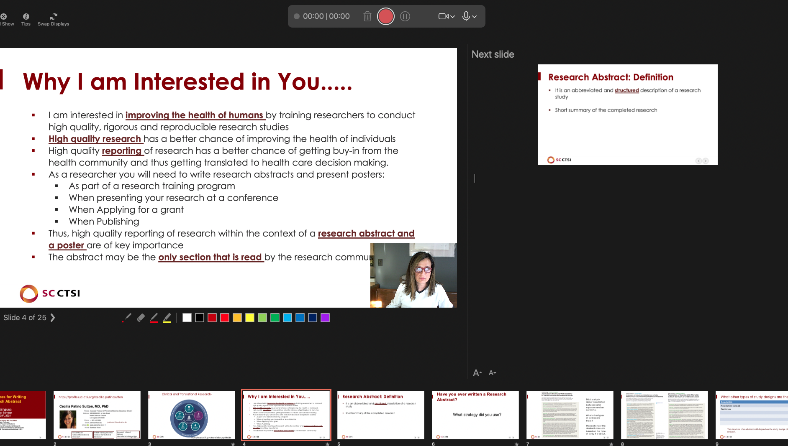
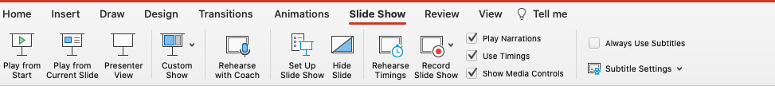
Preparing for the Presentation
Decide what section each of you will present, but make sure you know all the sections
Write out what each one will say, every single word!
Practice presenting your section, many times
Use PowerPoint capabilities to practice
Record your presentation so you can evaluate identify what sections to work on.
e.g., Write out what each one will say using

Slide 32





General Presentation Principles
Communicate, Advertise, Discuss
Clear Research Question
Two Main Points
Visually appealing
Rule of Six

Slide 33
Exercise on Easy Graphics
First point
Second point
Third point
Fourth point
Step 1: Make a carefully edited list

Slide 34
Exercise on Easy Graphics
First point
Second point
Third point
Fourth point
Step 2: Convert to Smart Art

Slide 35
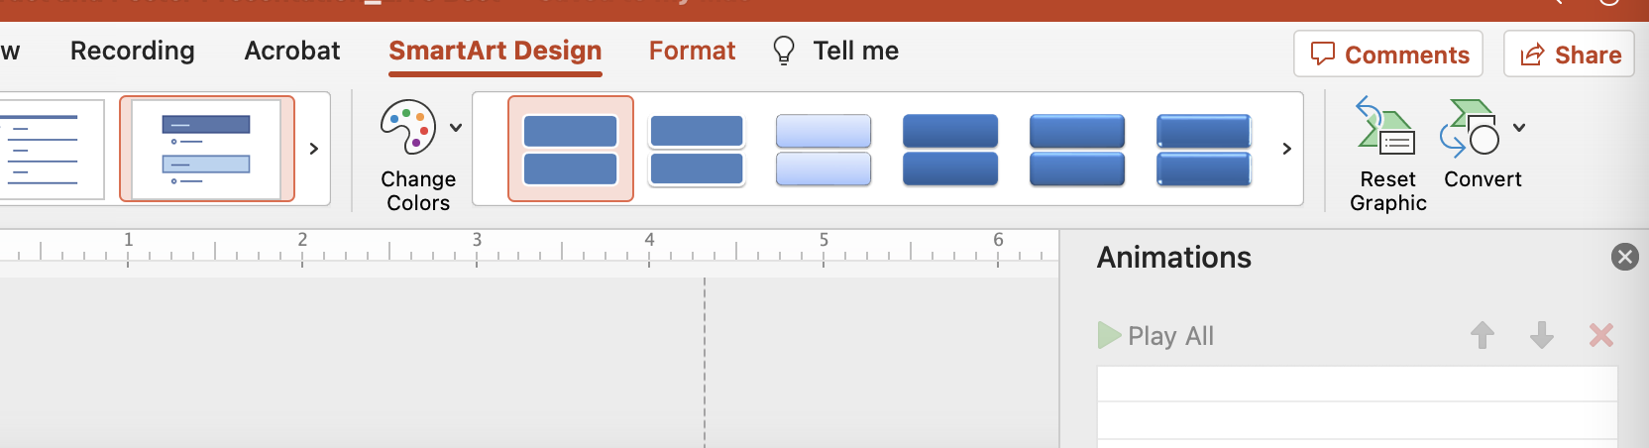
Exercise on Easy Graphics
First point
Second point
Third point
Fourth point
Step 3: Convert to Shapes & Ungroup

Slide 36
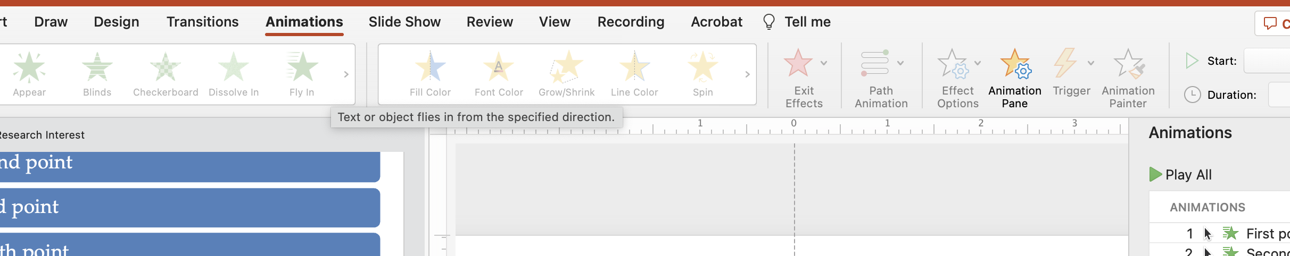
Exercise on Easy Graphics
First point
Second point
Third point
Fourth point
Step 4: Add Animation

Slide 37
Exercise on Easy Graphics
First point
Second point
Third point
Fourth point
Step 1: Make a carefully edited list

Slide 38

Samples from Summer 2023

Slide 39
Let’s summarize what we learned
Posters that are clear and concise do not intimidate the audience
Practice and write down every word you are going to say. PRACTICE!
Keep it easy to read, use graphs and tables, avoid word overload
Take advantage of Powerpoint capabilities

Slide 40
Exercise: Outline your poster
Objectives:
What is the significance to health?
Why is your research question important?
What is your study’s hypothesis?
Methods:
How were participants selected? (Flow diagram, Figure 1)
How was the data collected?
What variables were collected?
Was the data transformed/changed for analysis?
What analysis methods did you use?
Results:
Table 1: Describe study population: characteristics important to understand the results? Are they different between exposure groups?
What are main results? (Table/Figure 2)
What other results are you presenting?
Discussion
What do these results mean compared to other studies?
What is new? Why might it be different?
What is similar? Does this build confidence?
Submit in subfolder Posters: Folder

